Slide 1
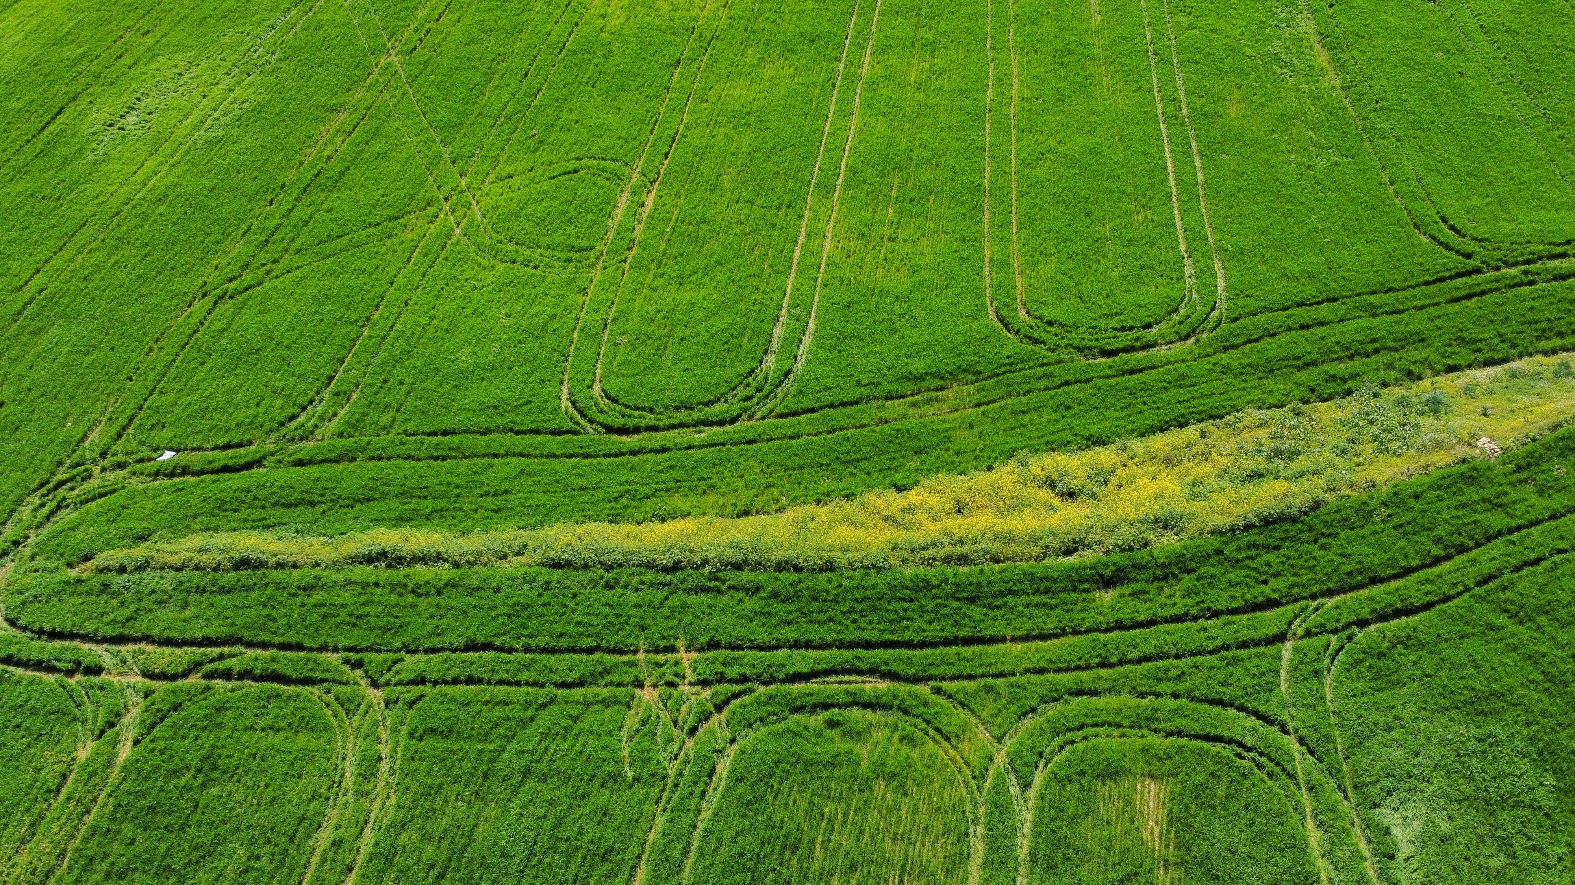
Machine Learning Analysis of Climate Change Impacts on Global Crop Yields Project by: Team 3 Anuhya Balineni Hari Gopal Chalamalasetty Sai Ramya Kasumurthy Sowmya Yalavarthi

Slide 2



Project Introduction
Climate change is altering global temperature and precipitation patterns, significantly impacting agricultural productivity and food security.
Rising CO₂ levels, extreme weather events, and shifting growing seasons threaten staple crops like wheat, Rice, Soybean and Maize.
This project leverages machine learning to analyze and predict climate change impacts on global crop yields, providing actionable insights for policymakers, farmers and stakeholders.

Slide 3
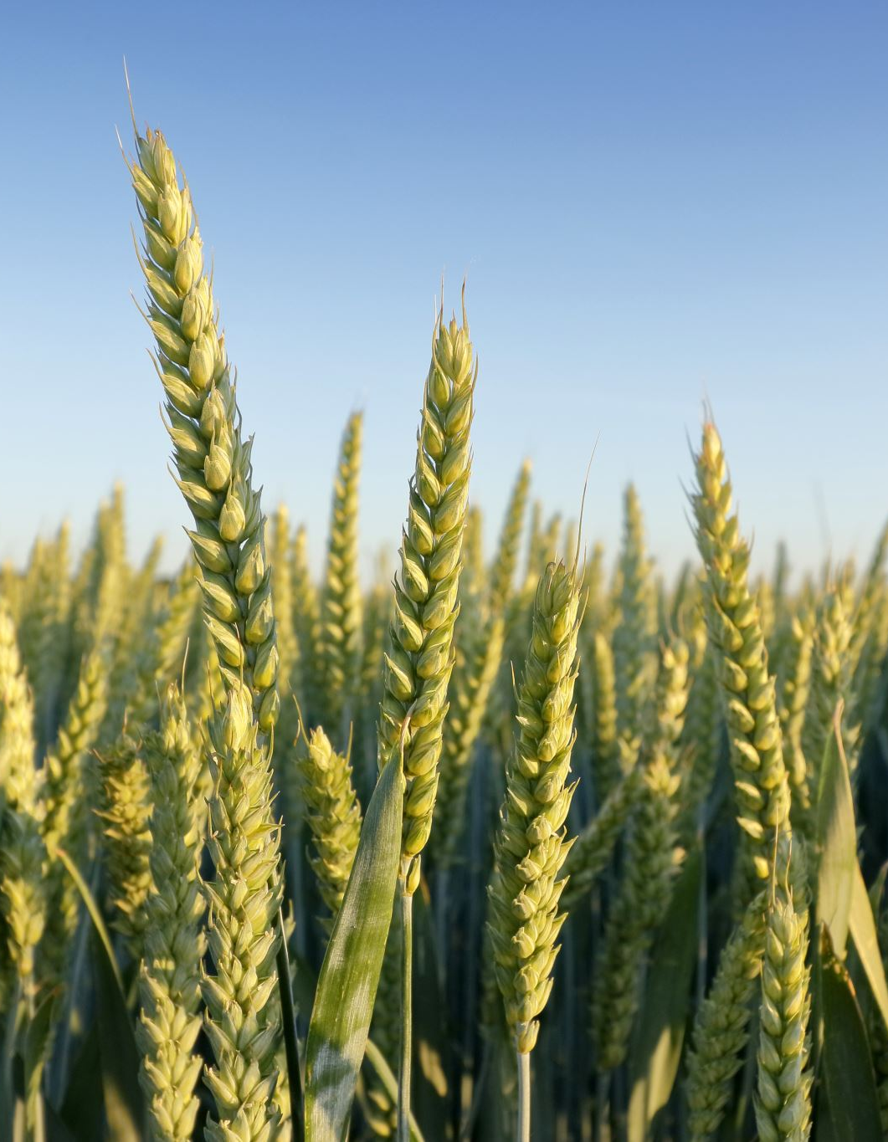
Problem Statement
Climate change poses a major risk to global food supply chains, potentially causing food shortages, economic instability, and social unrest.
Agricultural productivity will decline without a clear understanding of these impacts and effective adaptation strategies.
This project aims to develop a machine learning model to predict crop yield changes under various climate scenarios, helping stakeholders make informed decisions to ensure food security.

Slide 4
Literature Review
1. Impact of Climate Change on Crop Yield in Different Agro-Climatic Zones of India
Overview: Analyzes the effects of climate change on crop yields across various agro-climatic zones in India.
Key Findings: Identifies specific climate variables that significantly influence crop productivity, helping to inform region-specific agricultural strategies.
2. Predicting the Impacts of Climate Change on Maize Yields in the United States Using Machine Learning"
Overview: Applies machine learning methods to model maize yield responses to various climate change scenarios.
Key Findings: Highlights the potential decline in maize yields under extreme climate conditions, emphasizing the need for adaptive measures.

Slide 5
Literature Review
3. Machine Learning for Predicting Crop Yields: A Case Study on Wheat"
Overview: Investigates the effectiveness of different machine learning models in predicting wheat yields under varying climatic conditions.
Key Findings: Demonstrates the superiority of certain models in yield prediction, providing insights for precision agriculture practices.
4. Using Machine Learning to Assess Climate Change Impact on Crop Yields: A Case Study of Soybean
Overview: Evaluates the impact of climate change on soybean yields using machine learning techniques.
Key Findings: Provides actionable insights for farmers to adjust planting strategies based on predicted climate impacts, enhancing resilience.

Slide 6
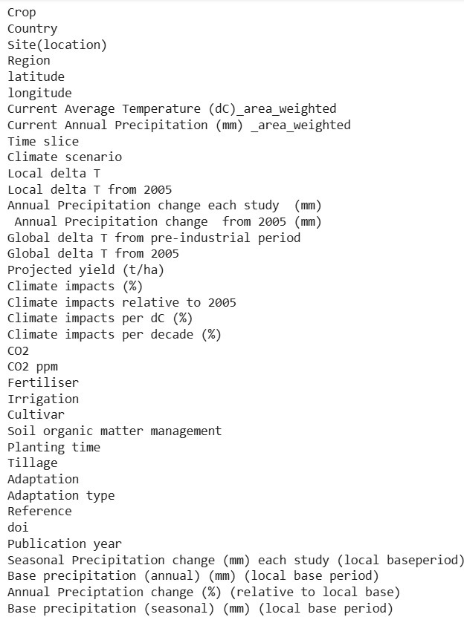
Dataset
The dataset is from the website “ Figshare”
It is a public dataset.
No of records: 8,703
No of columns: 38
No one has worked on this dataset before

Slide 7
Exploratory Data Analysis

Slide 8
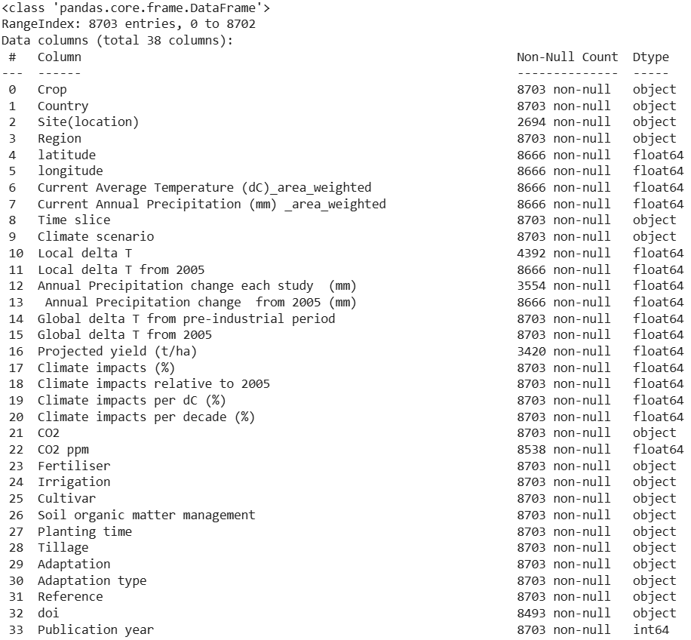
Data Preprocessing
The info function helps to display
the number of non-null values
present in the dataset.
We can observe that there are
some null values in the dataset.

Slide 9
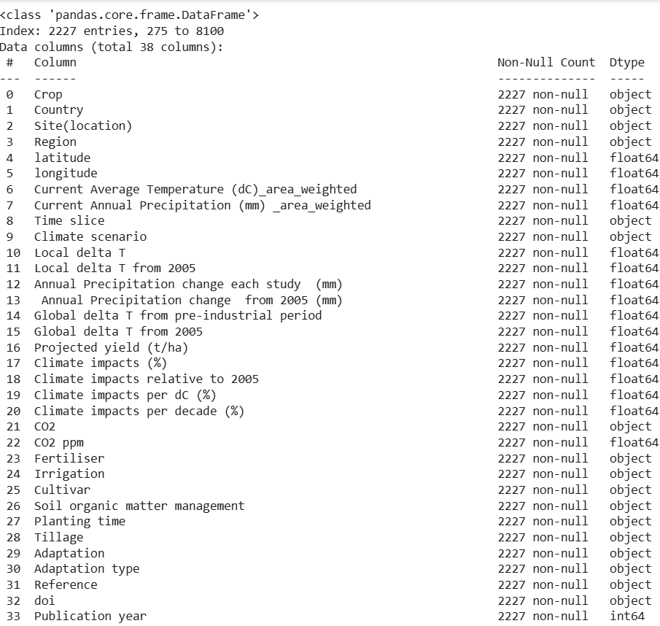
Null value treatment
Columns such as site(location), state, etc are categorical
in data type, so we have replaced the null values with the
mode, as mode gets the most frequent value.
Columns such as annual precipitation, projected yield
are numerical and as the data in those columns are
positively skewed, we replaced the columns with median.
After filling the null places with their respective imputed
values, we can observe there are no null values present
in each column

Slide 10
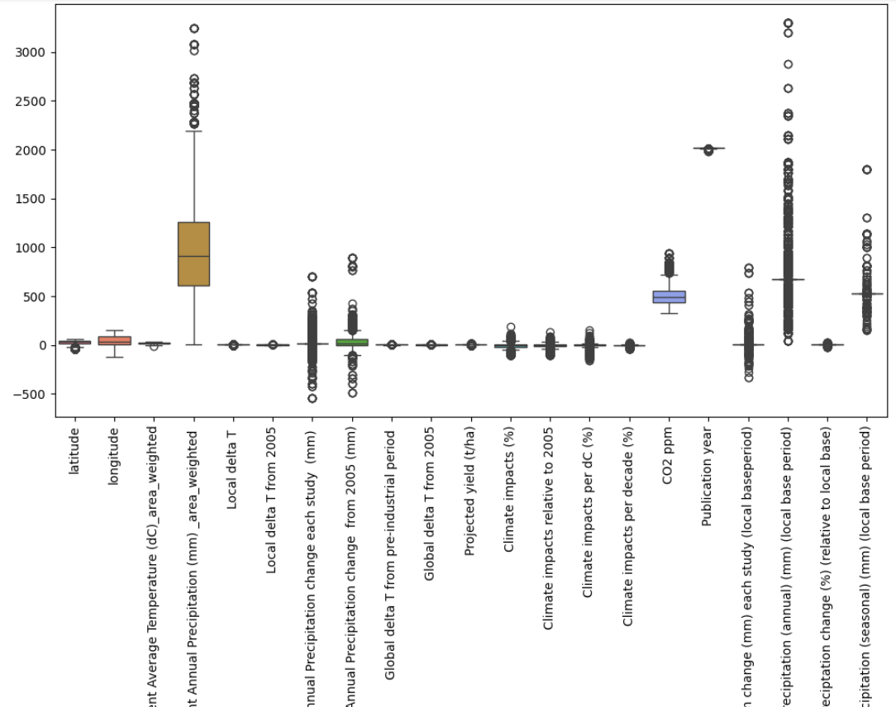
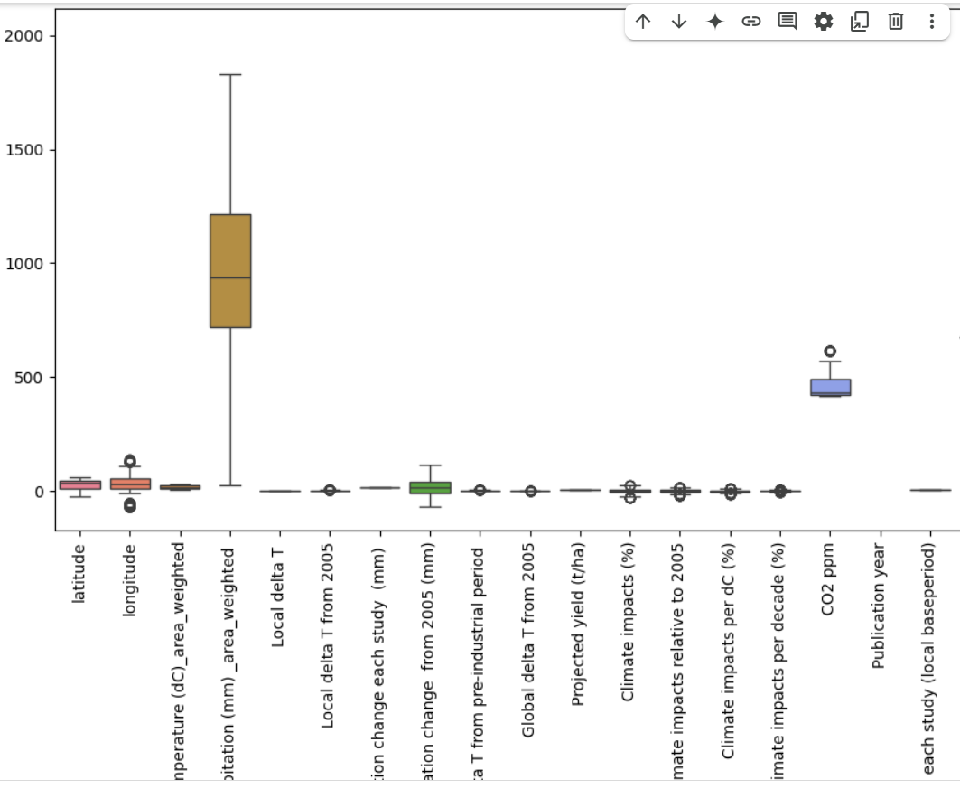
Outlier treatment
From the boxplots in the above figure we can observe that columns such as current annual precipitation, base precipitation columns have high outliers.
Using IQR Method we have removed the outliers as IQR helps to detect Outliers and is a method that dictates that any data point in a boxplot that's more than 1.5 IQR points below the first quartile data or more than 1.5 IQR points above the third quartile data is considered an outlier.
After Perform that the outliers have been reduced significantly.

Slide 11
Data Visualization

Slide 12
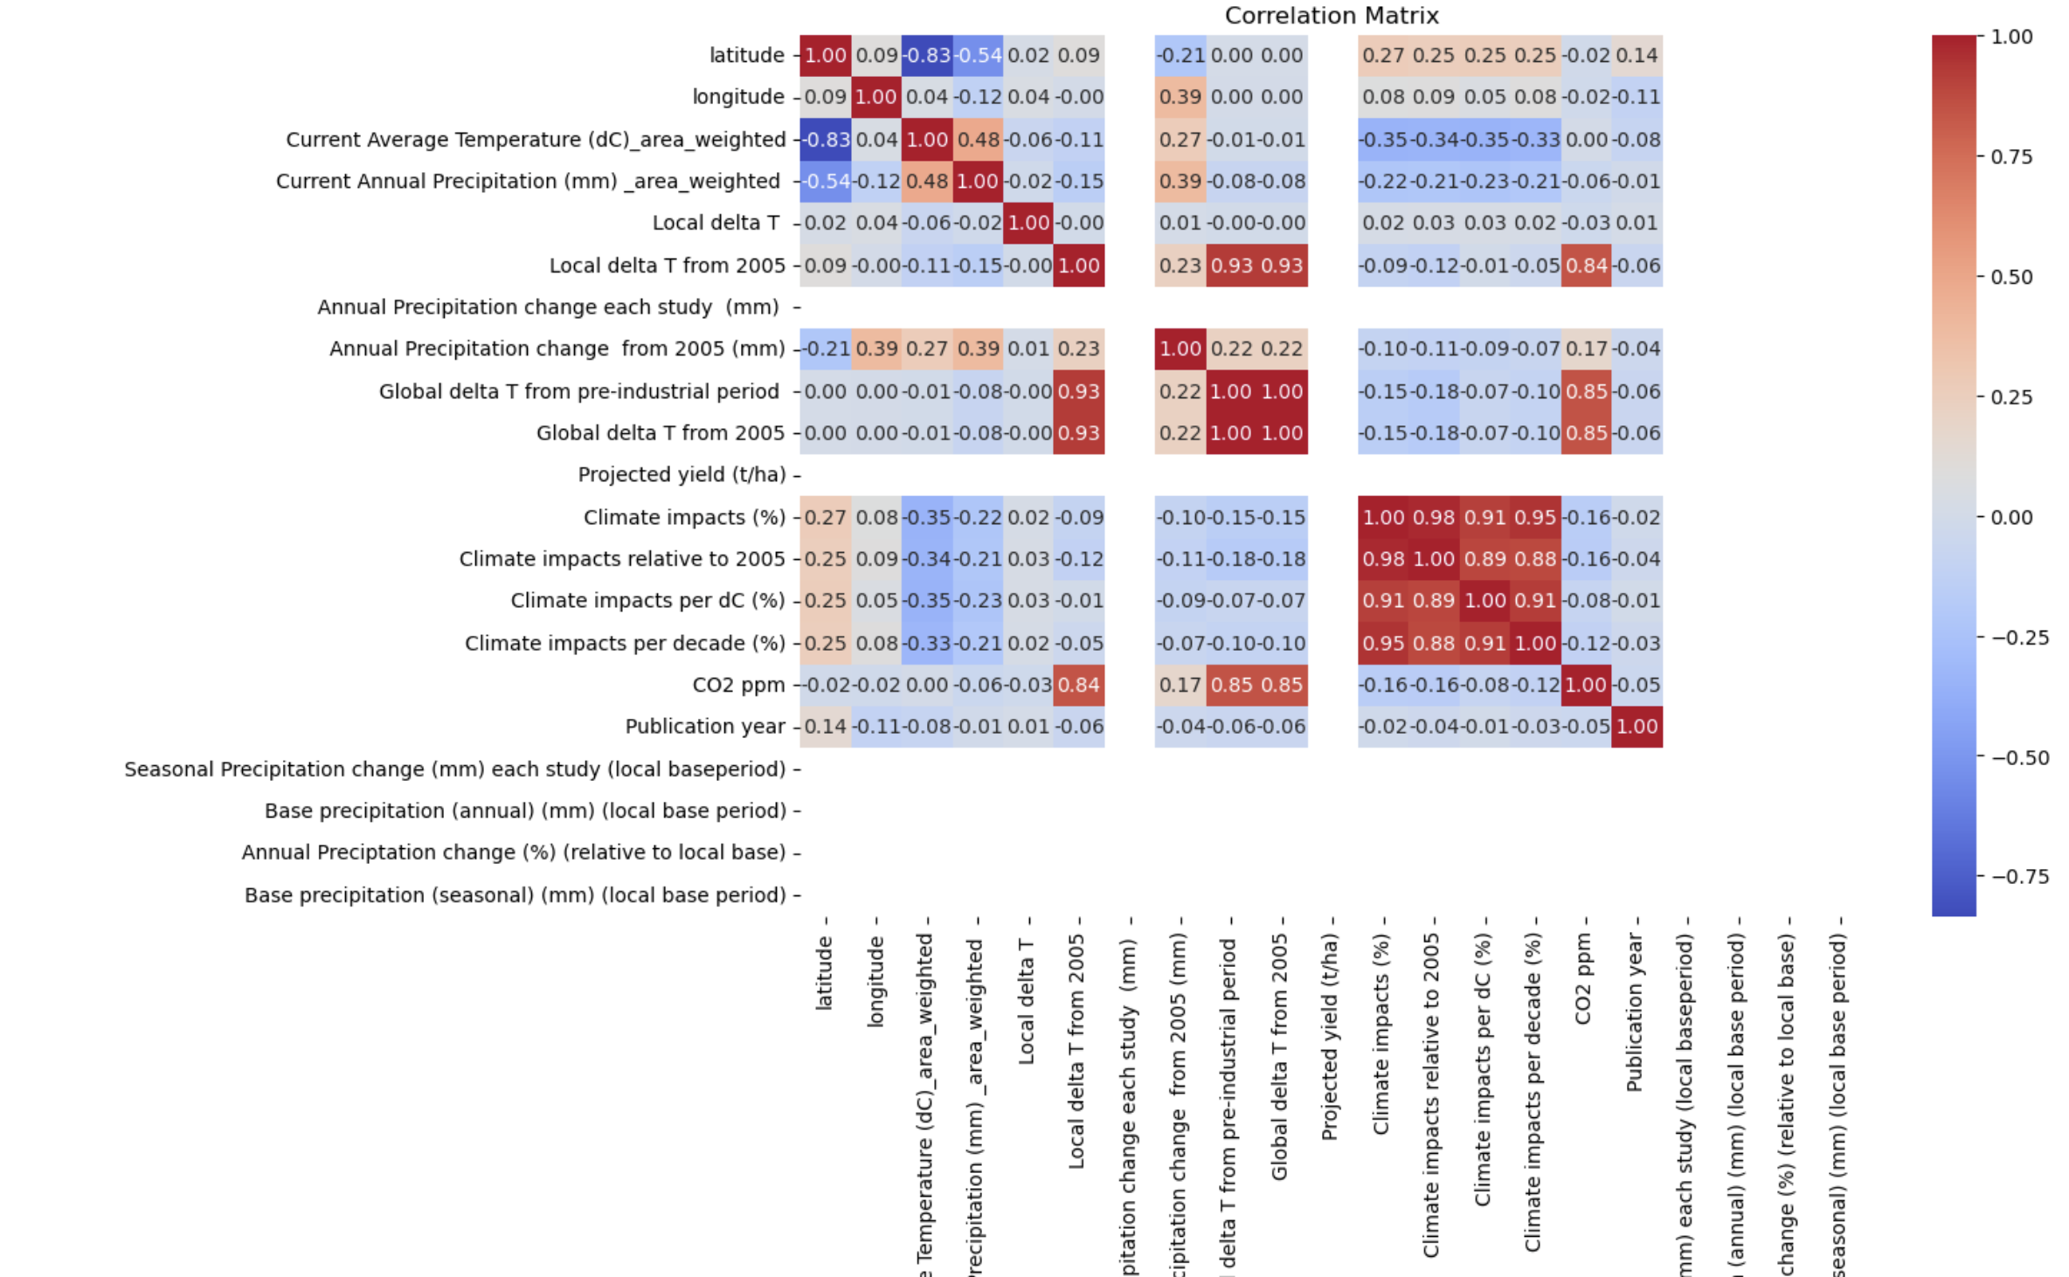
Latitude & Temperature: Latitude has a strong negative correlation with current average temperature (-0.83), meaning temperatures decrease as latitude increases.
Precipitation & Temperature: Current annual precipitation negatively correlates with temperature (-0.48), indicating regions with higher temperatures tend to have lower precipitation.
Global & Local Temperature Change: Global delta T from the pre-industrial period has a strong positive correlation (0.93) with local delta T from 2005, confirming global warming trends.
Climate Impacts: Climate impact metrics are positively correlated with temperature changes, suggesting higher temperatures lead to increased agricultural stress.
CO2 Levels: CO2 ppm shows a strong correlation with climate impacts, highlighting the role of greenhouse gases in climate change.

Slide 13
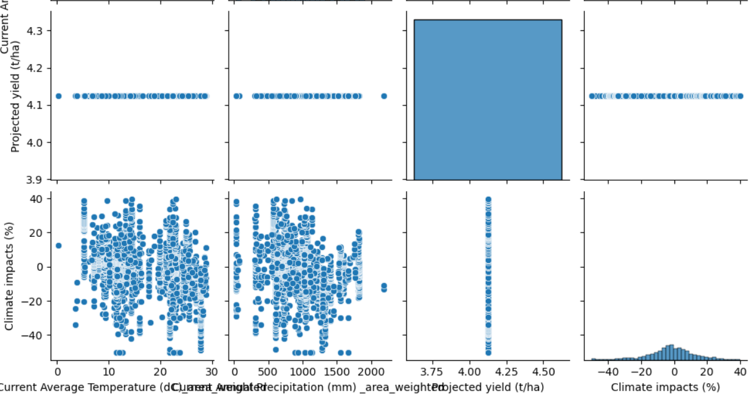
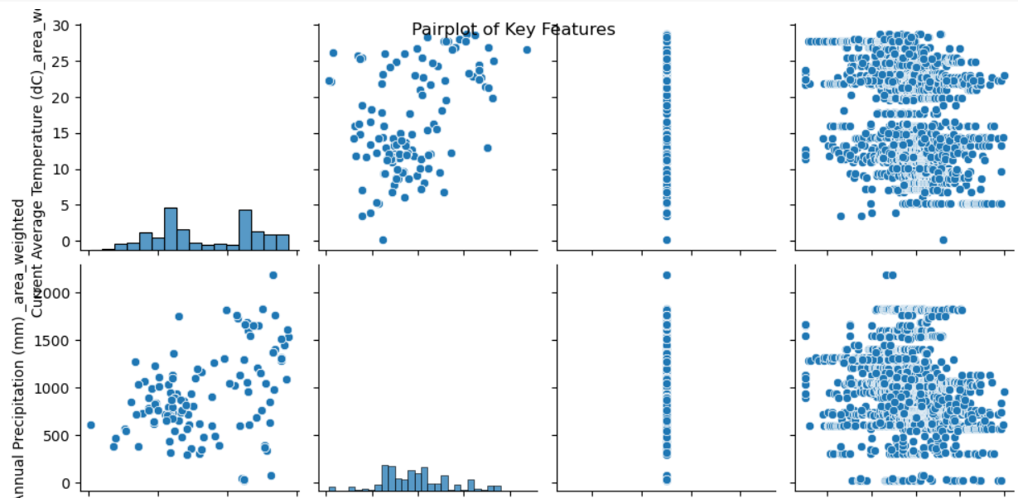
The pairplot visualizes the relationships between key climate and agricultural features, including temperature, precipitation, projected yield, and climate impacts.
The diagonal histograms show the distribution of each variable, revealing patterns such as skewness in precipitation and temperature.
Temperature vs. Climate Impacts: There appears to be a scattered relationship, indicating that temperature variations influence climate impacts but without a clear linear pattern.
Precipitation vs. Climate Impacts: The data suggests variability, with a spread of points showing a diverse impact of precipitation on climate effects.
Projected Yield: The projected yield seems to have a fixed or limited range, potentially indicating a categorical or imbalanced distribution.
The pairplot helps identify dependencies and potential trends that will guide further analysis in assessing the impact of climate change on crop yields.

Slide 14
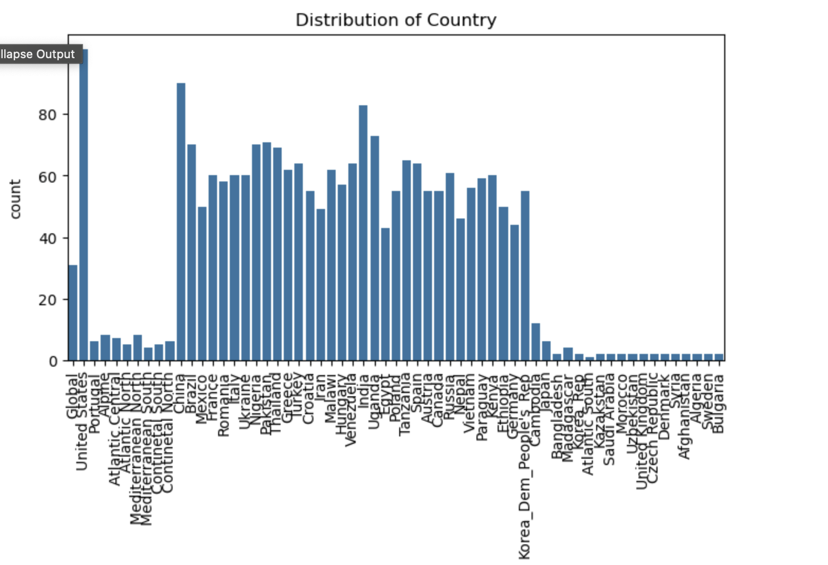
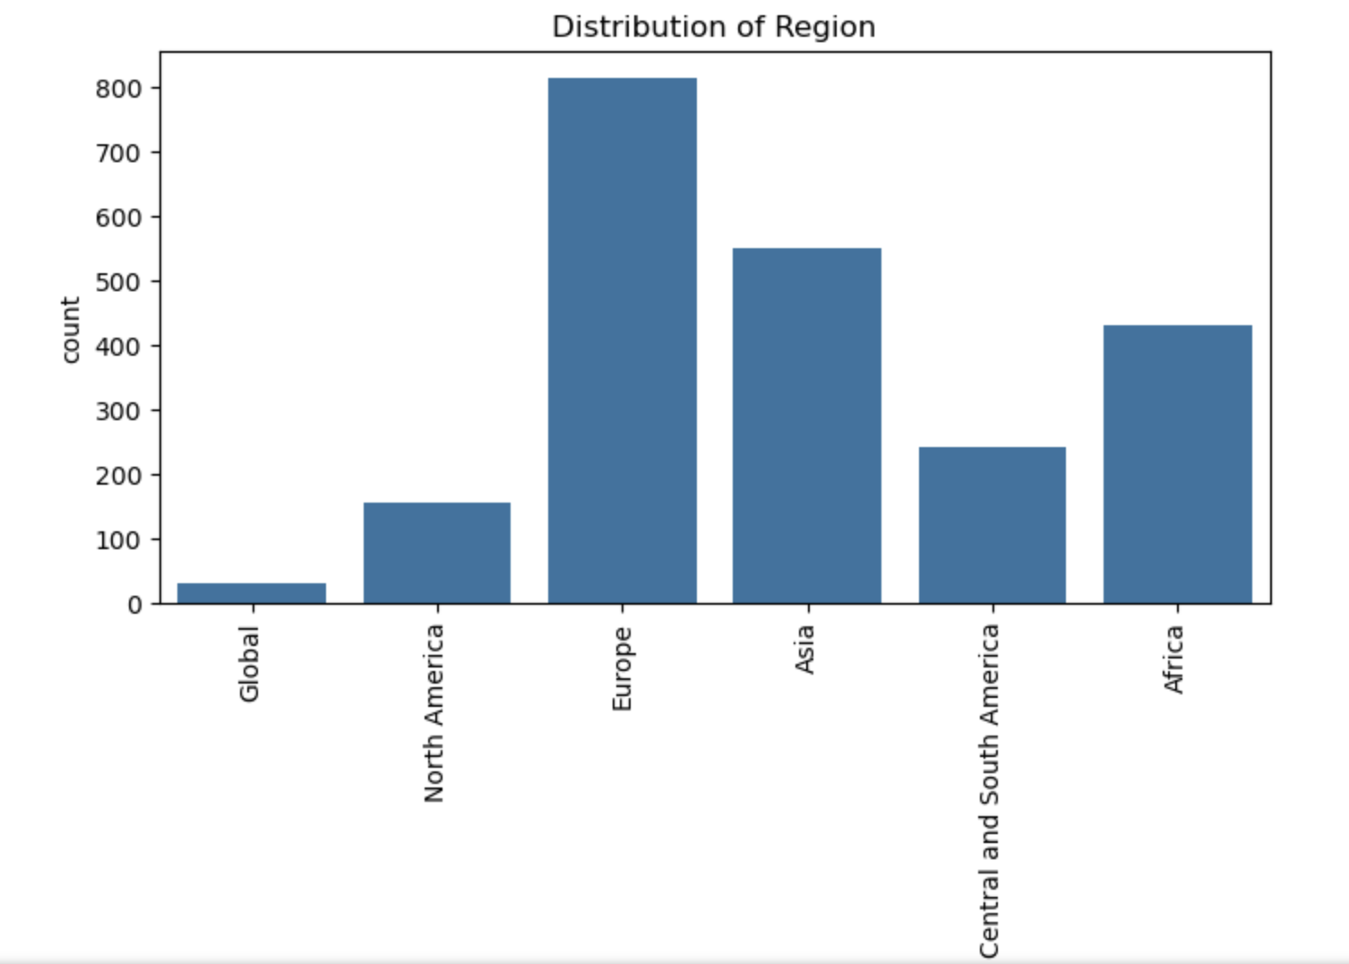
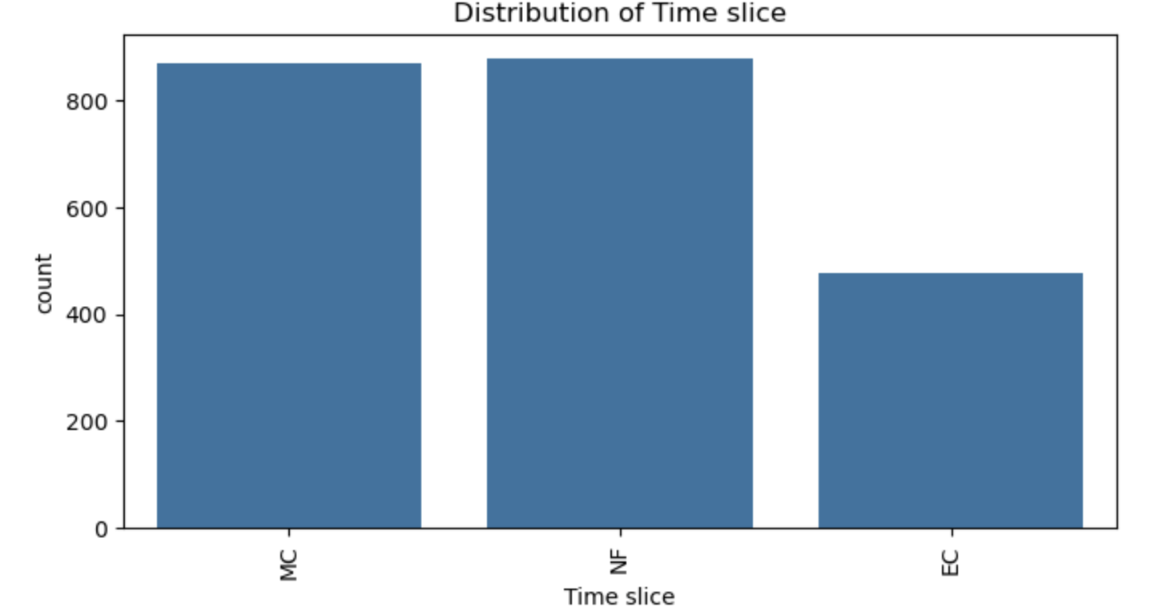
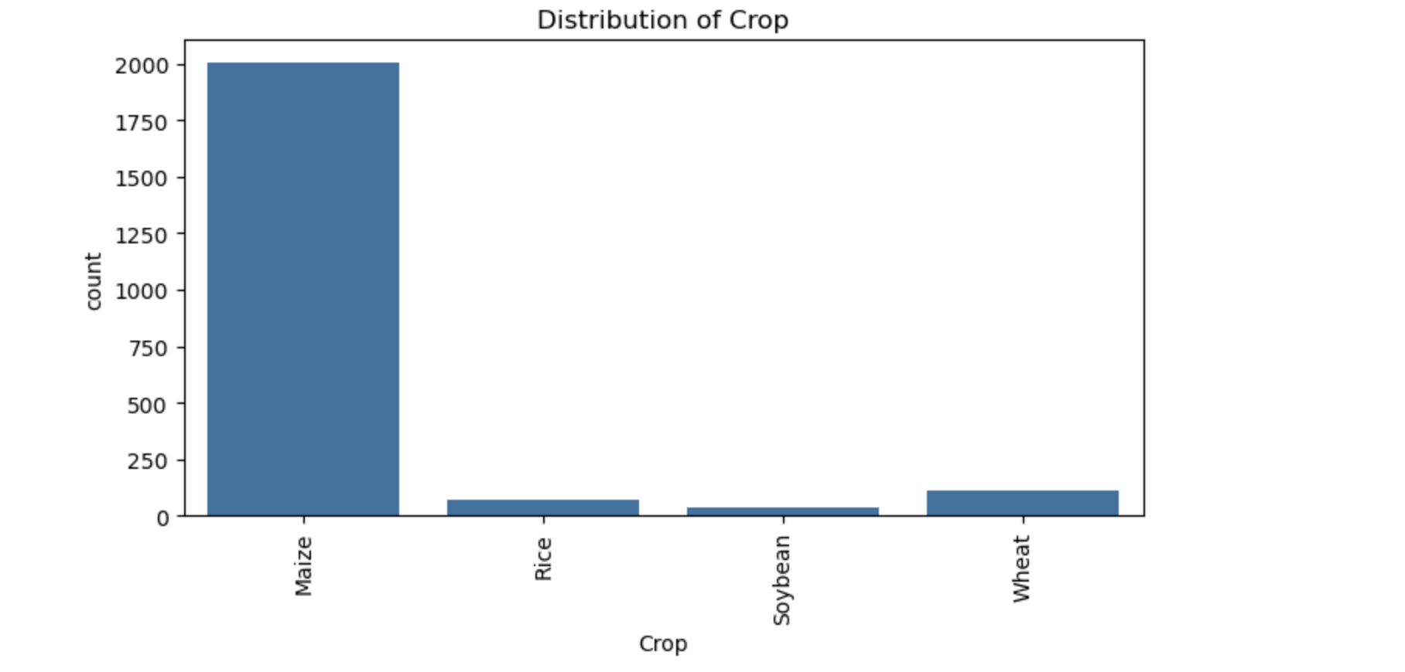
Categorical Feature Analysis
Which region has the highest representation in the dataset. Useful for regional analysis of crop yields and climate impacts.
Which crop is most frequently studied in the dataset. Useful for crop specific yield prediction and climate impact analysis.
Useful for analyzing how crop yields and climate impacts evolve over time.
Helps to understand geographic coverage and potential biases in the dataset.

Slide 15
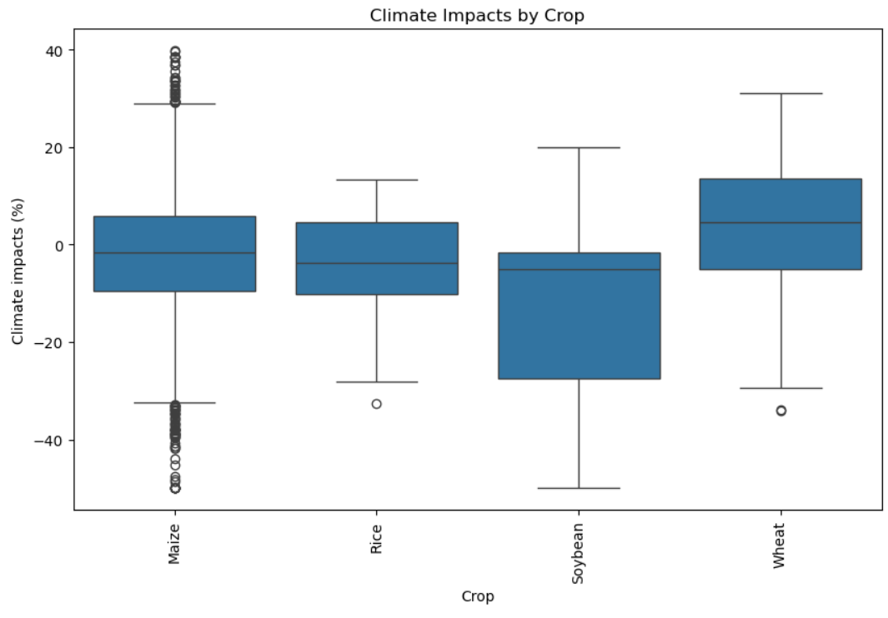
Climate Impact Variation: Different crops experience varying levels of climate impact, with some showing more negative effects.
Maize: Has the highest number of negative outliers, indicating it is more vulnerable to extreme climate conditions.
Soybean: Shows a wider spread of climate impacts, with both positive and negative variations. Wheat: Generally experiences more positive climate impacts compared to other crops.
Rice: Displays a relatively stable impact range with fewer extreme variations.

Slide 16
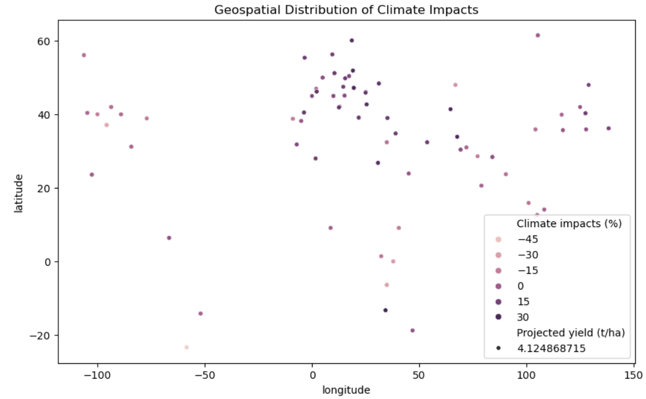
Geospatial Distribution: The chart visualizes climate impacts across different latitudes and longitudes.
Color Intensity: Darker points represent more positive climate impacts, while lighter points indicate stronger negative impacts.
Latitude Trends: Higher latitudes (above 40°) show varied climate impacts, with some regions experiencing significant negative effects.
Projected Yield: The black points indicate projected crop yield (t/ha), which shows variations across regions.
Regional Differences: Some areas, especially near the equator, seem to experience more negative climate impacts compared to others.

Slide 17
Proposed solution
Objective: Predict climate change impacts on global crop yields using machine learning.
Key Steps:
Data Collection: Gather climate data (temperature, precipitation, CO₂) and crop yield data.
EDA: Analyze relationships between climate variables and crop yields.
Model Development: Build predictive models using Regression models for yield prediction and classification models for identifying high-risk regions.
Adaptation Strategies: Evaluate strategies like irrigation changes, planting time adjustments, and crop diversification.
Reporting: Create interactive dashboards and reports for stakeholders.
Outcome: Provide actionable insights to ensure global food security.

Slide 18
Model & Algorithm
Data Pipeline:
Input: Climate data, crop yields, agricultural practices.
Preprocessing: Clean, normalize, and split data.
Feature Engineering: Create relevant features (e.g., growing degree days).
Model Training:
Algorithms: Linear Regression, Random Forest classifier, Gradient Boosting, Logistic Regression.
Evaluation: RMSE, MAE, R² metrics.
Interpretability: SHAP for model insights.
Output:
Predict crop yields under different climate scenarios (e.g., RCP 4.5, RCP 8.5).
Identify high-risk regions and crops.

Slide 19
References
Assessing the Impacts of Climate Change on Crop Yields in Different Agro-climatic Zones of India Naveen P Singh, Bhawna Anand, S K Srivastava, K V Rao, S K Bal, M Prabhakar
MMST-ViT: Climate Change-aware Crop Yield Prediction via Multi-Modal Spatial-Temporal Vision Transformer
IPCC. Summary for Policymakers. In: Global Warming of 1.5°C. Masson-Delmotte, V., P. Zhai, H.-O. Pörtner, D. Roberts, J. Skea, P.R. Shukla, A. Pirani, W. Moufouma-Okia, C. Péan, R. Pidcock, S. Connors, J.B.R. Matthews, Y. Chen, X. Zhou, M.I. Gomis, E. Lonnoy, T. Maycock, M. Tignor, & T. Waterfield (Eds.)], World Meteorological Organization, Geneva, Switzerland, 2018.
Kalra N., and Aggarwal P. K. (1996), ‘Evaluating the growth response for wheat under varying inputs and changing climate options using wheat growth simulator – WTGROWS’, in Abrol Y. P., Gadgil S., and Pant G. B., eds, Climatic Variability and Agriculture, Narosa Publishing House, New Delhi, pp 320–338.
Lal M., Singh K. K., Srinivasan G., Rathore L. S., and Naidu D. (1999), ‘Growth and yield response of soybean in Madhya Pradesh, India to climate variability and change’, Agriculture and Forest Meteorology, Vol 93, pp 53–70.

Slide 20

Aggarwal P. K., and Kalra N. (1994), ‘Analyzing the limitations set by climatic factors, genotype, water and nitrogen availability on productivity of wheat. II. Climatically potential yields and optimal management strategies’, Field Crops Research, Vol 38, pp 93–103.
Chatterjee A. (1998), ‘Simulating the impact of increase in carbon dioxide and temperature on growth and yield of maize and sorghum’, MSc thesis, Division of Environmental Sciences, IARI, New Delhi.
Gadgil S., Abrol Y. P., and Rao P. R. Seshagri (1999a), ‘On growth and fluctuation of Indian food grain production’, Current Science, Vol 76, pp 548–556.
Hundal S. S., and Kaur P. (1996), ‘Application of CERES-Wheat model to yield prediction in the irrigated plains of the Indian Punjab’, Journal of Agricultural Sciences (Cambridge), Vol 129, pp 13–18.
Mandal N. (1998), ‘Simulating the impact of climatic variability and climate change on growth and yield of chickpea and pigeonpea crops’, MSc thesis, Division of Environmental Sciences, IARI, New Delhi.
Sahoo S. K. (1999), ‘Simulating growth and yield of maize in the different agro-climatic regions’, MSc thesis, Division of Environmental Sciences, IARI, New Delhi.

Slide 21

THANK YOU

